Slide 1
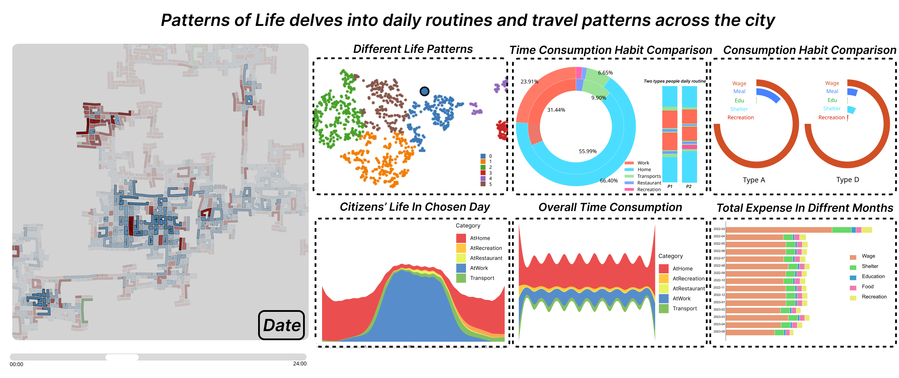
Pattern of Life in ShanghaiTech City
王芸飞，贾舜康，夏康杰

Slide 2
Task Purpose
Draw a map
Analyze City Patterns
Busy areas
Traffic bottlenecks
Economic changes
Reveal Life Patterns of Citizens
Money expenses for different purpose
Time spent for different purpose
Better City, Better Life
Provide insights for the government to improve

Slide 3
Design & How to manipulate data
Dynamic Map for distinguishing areas and showing traffic bottlenecks.
Scatter Plot for cluster to classify different lifestyles, with pie charts for details and comparison
StreamRiver and Stacked Bar Graph to show changes in city pattern

Slide 4
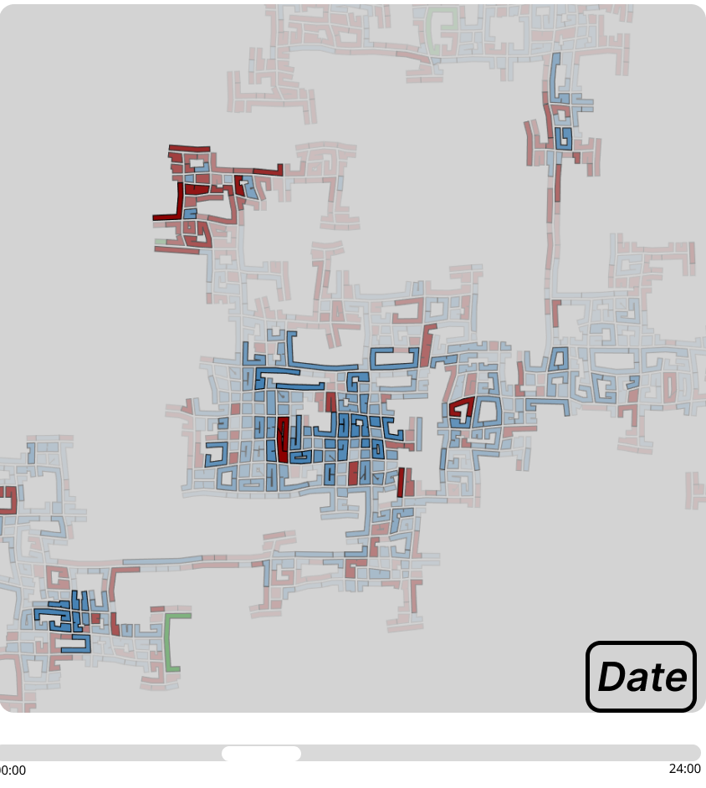
Map Overview (Static)
1. Build Map
Buildings.csv
2. Distinct Areas
Building.csv + schools,pubs
3. Busy Areas
Residental: Highlight By Rental Cost in apartments.csv
Commercial: Highlight By Checkin Journal

Slide 5
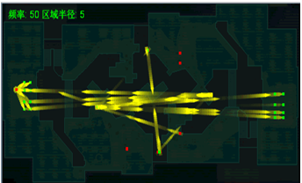
Dynamic Map with Traffic Flow
Dynamic Traffic Flow in One selected Day
Activity Logs: use logs with transport category
Use Bullet effect to hightlight busy roads
Mark red trajectory with slow speed

Slide 6
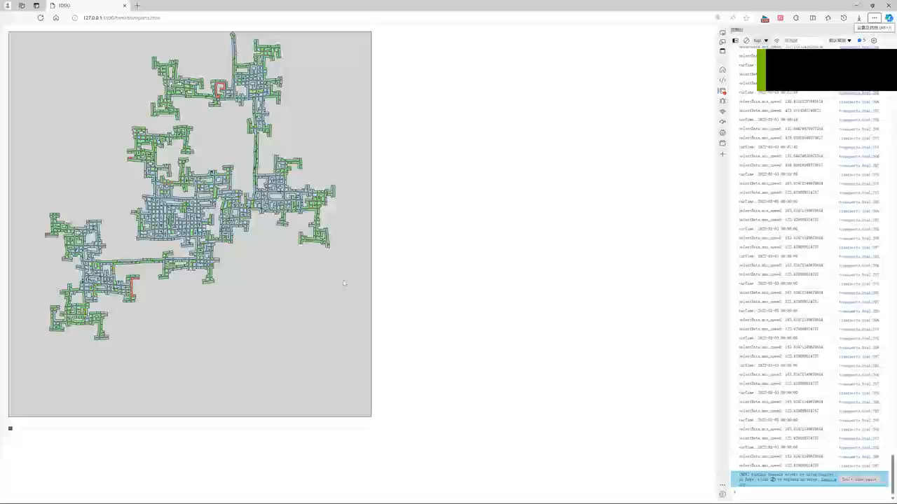

Slide 7
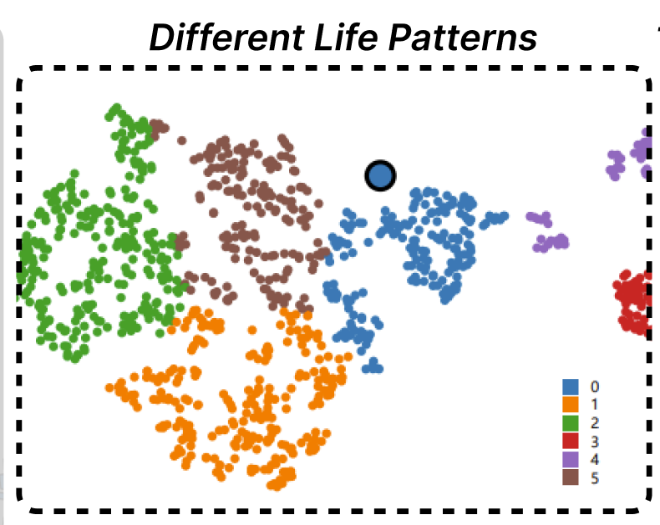
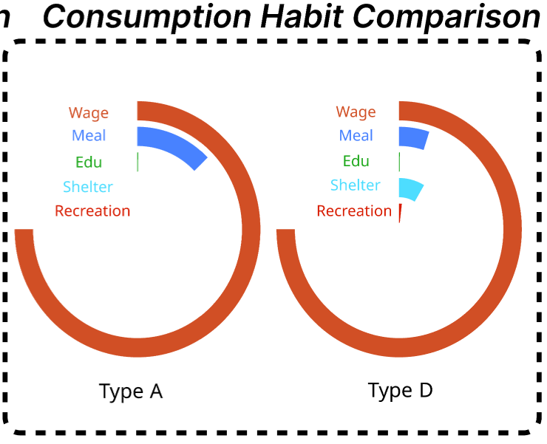
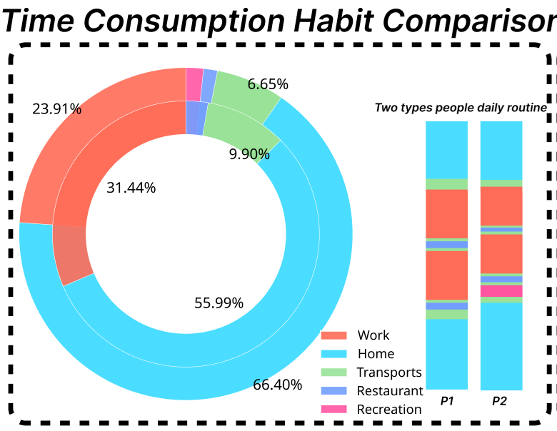
Citizens’ Life Pattern
Cluster Method
Comparison

Slide 8
Cluster Prepare
Time Dimension Feature
Sum up the corresponding time of different Mode of each people in activitylog.csv.
{"AtHome", "Transport", "AtRecreation", "AtRestaurant", "AtWork" }
Consumption Dimension Feature
Sum up the corresponding amount of different category financial change of each people in FinancialJournal.csv.
{“Education”, “Food”, “Recreation ”, “Shelter”, “Wage”}
Dimension reduced
PCA, TSNE and MDS
Notes:
The final weight of each activity time per person is obtained by summarizing the data in activitylog.csv, focusing mainly on the currentMode column.
By aggregating the data in FinancialJournal.csv, the percentage of each person's economic activity is counted, and these characteristics are then used to characterize a person's economic situation.

Slide 9
Comparison(Time)
Multi-layer Pie Chart:
Show and compare time dimension feature overview of different life patterns.
Time Line of two specific persons daily routines
Weekdays and weekends.
Show and compare two different specific daily routines.

Slide 10
Comparison(Money)
Circle Track
Show and compare the consumption habit of different types persons

Slide 11
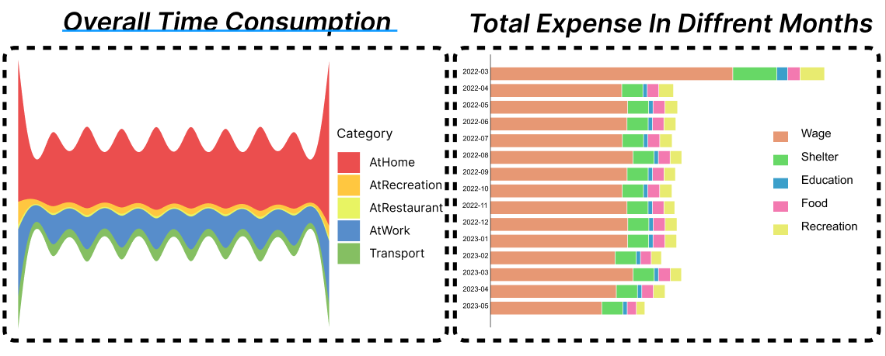
Changes
Streamriver Graph
Time consumption of all citizens monthly
Horizontal Stack Bar Chart
Consumption of all citizens monthly

Slide 13
Cluster
Full data summary
Time_weighting ：The final weight of each activity time per person is obtained by summarizing the data in activitylog.csv, focusing mainly on the currentMode column.
Money_weighting ：By aggregating the data in FinancialJournal.csv, the percentage of each person's economic activity is counted, and these characteristics are then used to characterize a person's economic situation.
最终使用这10个特征进行聚类，分别使用了PCA,TSNE,MDS三种聚类方法，最终选择了TSNE聚类的结果并将其绘制。然后将label带回，再去计算了每个类别在高维情况下的聚类中心，绘制了每个类别对应的饼图图表，来清晰的展示和比较该类别的不同之处
The final clustering using these 10 features was done using three clustering methods PCA,TSNE,MDS and finally the results of TSNE clustering was chosen and plotted. Then the labels were brought back and the clustering centers were calculated for each category in the high dimensional case, and the corresponding pie charts for each category were drawn to clearly show and compare the differences between the categories.
在第三问的处理数据基础上，我们稍加修改，就可以统计出每天或每月每人的时间花费情况以及每月每人的消费情况来绘制对应的河流图和柱状图，以便发现在一天中或随季节变换，人们生活方式的转变，最终探究这背后，城市的pattern变化
On the basis of the processed data in the third question, with a little modification, we can count the time spent per person per day or per month as well as the consumption per person per month to draw the corresponding river charts and bar charts, in order to find out the transformation of people's lifestyles in the course of a day or with the change of seasons, and finally to explore the changes of patterning in the city behind this.

